Slide 1
Electronic Structure of Single-Walled Carbon Nanotubes (SWNT)
Nan Zheng
Solid State II
Instructor: Elbio Dagotto
Spring 2008
Department of Physics
University of Tennessee
Email: nzheng@utk.edu

Slide 2
Outline
Introduction
Band Structure Calculation
Conducting Properties and Applications
Summary

Slide 3
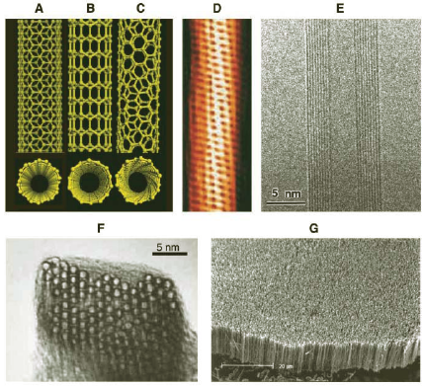
Introduction I: structures overview
A: armchair SWNT
B: zigzag SWNT
C: chiral SWNT
D: helical structure of SWNT(TEM)
E: a MWNT (TEM)
F: a packing of lots of SWNTs (TEM)
G: nanotube forest of MWNTs (SEM)

Slide 4
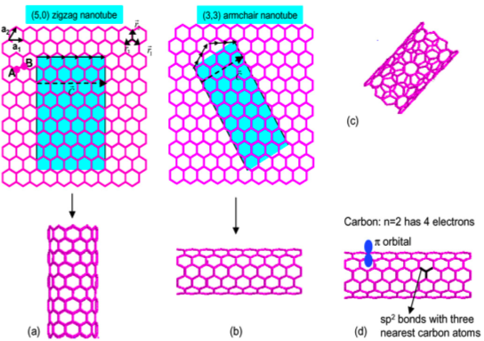
Introduction II: structures overview

Slide 5
Introduction III: defining strucures
Chiral vector (m,n) describes how to “roll up” the graphene sheet to make nanotubes.
Three types of SWNTs:
1. Zigzag (m=0 or n=0)
2. Armchair (m=n)
3. Chiral (others)

Slide 6
Introduction IV: Semiconductor or metal?
Experimental Facts:
Graphene Semi-Metal
Single-Walled Carbon Nanotubes
All armchair SWNTs (m=n) are metals
Those with n-m=3I (I is a non-zero integer) are semiconductors with tiny (~meV) band gap (or semimetals)
Others are semiconductors with band gap dependent on nanotube diameter

Slide 7
Band Structure Calculation I: introduction to tight binding approach
Idea: construct linear combination of atomic wavefunctions of each unit cell to achieve bloch wavefunction.
Secular Equation:
with
where H is transfer integral matrix;
S is overlap integral matrix;
C is a vector with all coefficients of
bloch wave in terms of atomic wavefunctions.

Slide 8
Band Structure Calculation I: introduction to tight binding approach
How:
Specify unit cell and unit vectors;
Specify Brillouin zone and reciprocal lattice vectors. Select high symmetry directions and momentum along the high symmetry axes;
For the selected momentum points, calculate the transfer and overlap matrix element, H and S.
For the selected momentum points, solve the secular equation and obtain the eigenvalues and eigenstates.

Slide 9
Band Structure Calculation II: Graphene First
Graphene lattice
Reciprocal lattice
Nearest Neighbor Assumption:
( is called transferred integral constant)
Linear combination of the three nearest neighbors:

Slide 10
Band Structure Calculation II: Graphene First
Transfer and overlapping matrices:
Solving secular equation gives:

Slide 11
Band Structure Calculation II: Graphene First

Slide 12
Band Structure Calculation III: Carbon Nanotube
How :
Adding periodic boundary condition to graphene tight-
binding calculation along the circumferential direction.
Example :
For armchair structure (m=n),
(with n to be the chiral integer)
Dispersion relation

Slide 13
Band Structure Calculation III: Carbon Nanotube
General result for carbon nanotube:
Nanotubes with n-m=3I, where I is a integer, are metals with no energy gap;
Others are semiconductors with a bandgap which decreases with the increase in nanotube diameter:
with

Slide 14
Band Structure Calculation III: Carbon Nanotube
Comparing with Experiment:
All armchair nanotubes (m=n) are metallic
Nanotubes satisfying m-n=3I develops a tiny band gap
(for example, a 10A nanotube has a 40meV gap)
Nanotubes not satisfying m-n=3I are semiconductors with an energy gap inversely varied with diameter
(for example, a 10A nanotube has a 1eV gap)
Deviation from experiment due to curvature:
The transitional integral constants ( s) of the three nearest neighbors are not identical
Hybridization becomes important

Slide 15
Conducting Properties and Applications I: Conducting Properties
Metallic CNTs have remarkable conducting ability:
Electrons can travel as long as several micrometers without being back scattered.
(compare with copper: scattering length being several nanometers)
Conductance of semiconducting CNTs are as good as copper when gate voltage increases
Reason:
Electrons in 1D system can only be scattered by
completely reversing its direction, while in higher
dimensional systems scattering can occur even by
a small angle.

Slide 16
Conducting Properties and Application II: Semiconducting CNTs as transistors
Advantages of semiconducting CNTs:
Small size (of course!)
No more surface states in 3D materials

Slide 17
Conducting Properties and Application III: Novel Device: Rectifier

Slide 18
Summary
Carbon nanotubes can be semiconductor or metallic depending on their chiral structures. Main physics can be achieved using nearest neighbor tight binding approach.
Remarkable electronic properties of both metallic and semiconducting carbon nanotubes make them promising candidate material for future molecular devices.
Challenges for eventual application:
Fabrication in a controlled fashion
Integration into existing microelectronic system

Slide 19
References
[1] S. G. Louie, Top. Appl. Phys. 80, 113 (2001).
[2] J. W. G. Wildoer, L. C. Venema, A. G. Rinzler, R. E. Smalley, C. Dekker, Nature 391, 59 (1998).
[3] A. Thess et al., Science 273, 483 (1996).
[4] R. H. Baughman et al., Science 297, 787 (2002).
[5] M. P. Anantram and F. Leonard, Rep. Pro. Phys. 69, 507 (2006).
[6] G. S. Painter and D. E. Ellis, Phys. Rev. B 1, 4747 (1970)
[7] R. Saito, G. Dresselhaus and M.. S. Dresselhaus, Physical Properties of Carbon Nanotubes, Imperial College Press (1998)
[8] R. A. Jishi, et al., J. Phys. Soc. Jpn. 63, 2252 (1994)
[9] C. T. White, D. H. Robertson and J. W. Mintmire, Phys. Rev. B 47, 5485 (1993).
[10] C. T. White and J. W. Mintmire, J. Phys. Chem. B 109, 52 (2005).
[11] J. W. Mintmire and C. T. White, Phys. Rev. Lett. 81, 2506 (1998).
[12] I. Cabria, J. W. Mintmire and C. T. White, Phys. Rev. B 67, 121406 (2003).
[13] X. Blase et al., Phys. Rev. Lett. 72, 1878 (1994).
[14] P. L. McEuen, Physics World 13, 31 (2000).
[15] L. Kouwenhoven and C. Marcus, Physics World 11, 35 (1998).
[16] W. H. A de, R. Martel, Physics World 13, 49 (2000).
[17] http://en.wikipedia.org/wiki/Carbon_nanotube

