Slide 1
introduction to photoemission application to layered oxides
Amal Al-Wahish
Course: Solid state 672
Prof. Dagotto
Department of Physics, UTK

Slide 2
OutLine
What is the photoemission? Why we need it?
Present a Historical Introduction
ARPES and Mathematical Formulas
Three-Step Model
Applications
How far this good compare to theory
Summary
References

Slide 3
photoemission
It utilizes the photoelectric effect , Photoelectric effect takes place with photons with energies of about a few eV
study of the electronic structure of solids.
powerful widely-used way to study the properties of atoms, molecules, solids and surfaces
Angular resolved photoemission spectroscopy (ARPES), provides rich information about the electron structure of crystals and of their surfaces

Slide 4
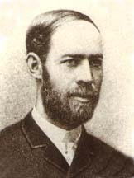
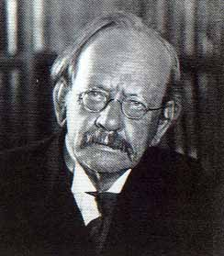

a Historical Introduction
In1887 Hertz observed that a spark between two electrodes occurs more easily if the negative electrode is illuminated by UV radiation.
A few years later J.J. Thompson demonstrated
that the effect was due to emission of electrons by the electrode while under illumination.
Einstein postulated that light was composed of discrete quanta of energy

Slide 5
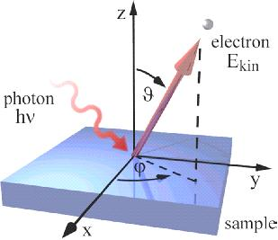
ARPES
A powerful imaging technique
measuring the energy and momenta of electrons ejected from a sample struck by energetic photons makes it possible to calculate the electrons' initial energy and momenta, and from this determine the sample's electronic structure.

Slide 6
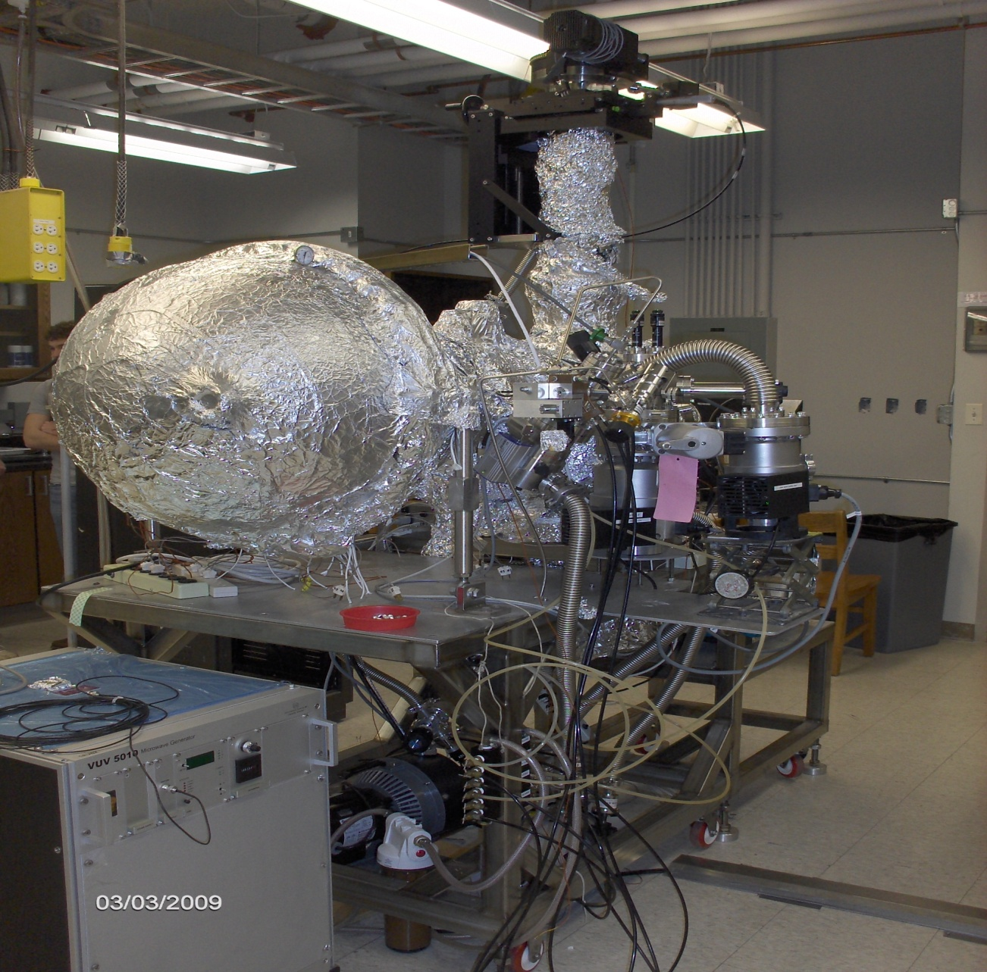
Photoemission Spectroscopy's system.

Slide 7
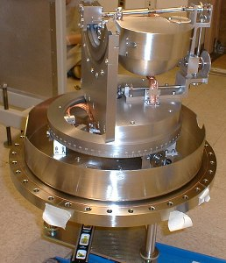
The ARPES sensor now sits inside the vacuum chamber. This picture was taken before it was completely built

Slide 8
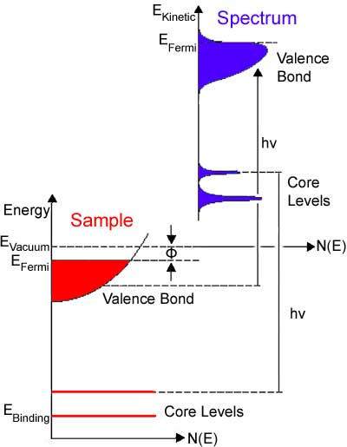
Sensor, in blue displays the intensity of detected electrons, N(E), that have various kinetic energies, E_{Kin}.
These values obtained by the ARPES sensor correspond to the actual values of the "Sample", displayed red. In a solid material, the electrons are distributed to an energy level below E_{Fermi}, the Fermi Level.

Slide 9
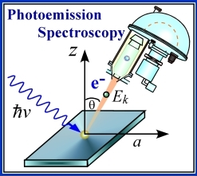
An ARPES sensor collects the photoelectrons, provide information about the photoelectron energy, applying conservation laws of energy and momentum, where the energy and the momentum is conserved before and after the photoelectric effect.
The crystal- momentum inside the solid

Slide 10
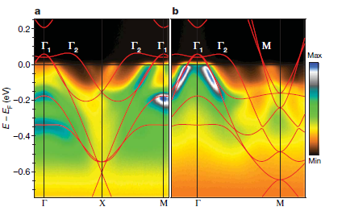
Low Photon Energies
Most ARPES experiments are performed at photon energies in the
ultraviolet (100 eV).
Why?
Conservation of momentum, we can neglect the photon momentum compare to the e-momentum.
Achieve higher energy and momentum resolution.
How?
Mapping out the electronics dispersion relations
by tracking the energy position of the peaks of ARPES spectral at various angles to achieve higher energy and momentum resolution .

Slide 11
corresponds to the finite acceptance angle of
the electron analyzer.
for 100-eV photons the momentum is 3%
of the typical Brillouin-zone size of the cuprates
0.05 A⁻¹ 2π/a ≈ 1.6 A⁻¹
for 21.2-eV photons the momentum is 0.5%
of the typical Brillouin-zone size of the cuprates
0.008 A⁻¹ 2π/a ≈ 1.6 A⁻¹

Slide 12
three-step model
Escape
of the
Photoelectron
from the surface
Transport of the excited photoelectron to the surface
Absorption of the x-ray inside the solid

Slide 13
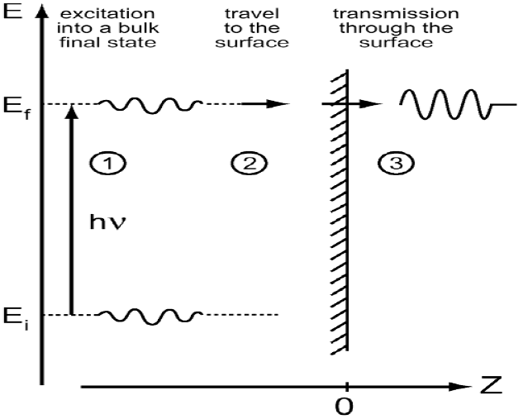
Sketch for Three model by Stefan Hüfner
The three step model developed on ARPES from solid by Berglund and Spicer.

Slide 14
The total photoemission intensity is then given by the product of three independent terms:
W
The total probability
for the optical transition
Γ_{emfp}
The scattering probability
for the traveling electrons
φ
The transmission probability
through the surface potential barrier.

Slide 15
Golden Rule
The Hamiltonian of one electron in a system described by a potential V(r), to which an
External electromagnetic field is applied:
Dipole approximation.

Slide 16
The interaction with the photon is treated as a perturbation given by
Approximations:
1- One-electron picture
2- First-order perturbation theory to calculate the interaction between the incident radiation and the system.
3- The flux of incident photons is relatively low.
4- Neglecting terms of order |A|² in the calculation of the photocurrent.

Slide 17
The one-electron dipole matrix element
The wave functions for the photoelectrons with the momentum k after and before the optical transition.
The total photoemission intensity I(k, E_{Kin} ) is proportional to

Slide 18
probability that the removal of an electron from state i will leave the (N-1)-particle system in the excited state m.

Slide 19
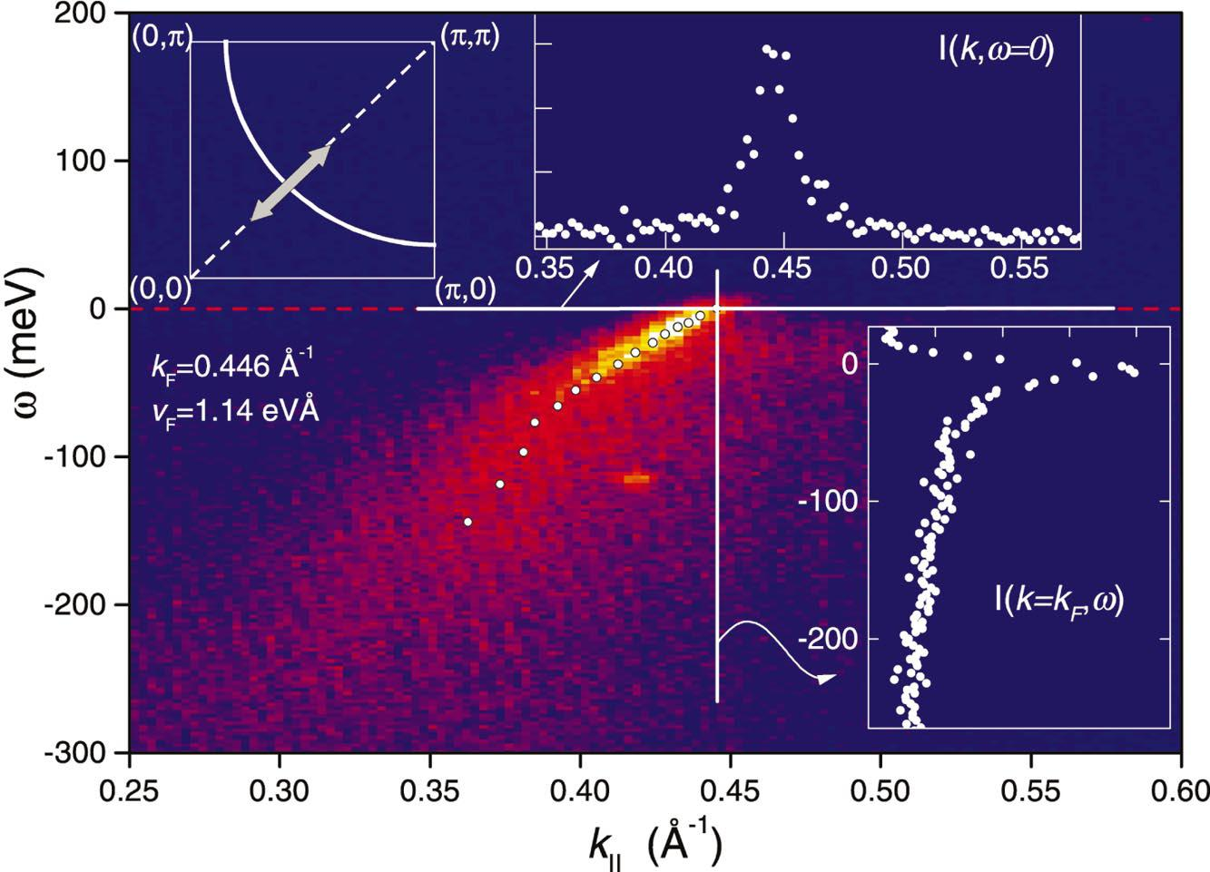
Application
ARPES on studying the high temperature superconductors such as copper oxide and Ione-based superconductor,
record the photoemission intensity versus the photoelectron kinetic energy.
ex. Bi₂Sr₂CaCu₂O_{8+x}

Slide 20
Shen’s group studied the electronic structure of LaOFeP by using ARPES. The purpose of this study was to understand the nature of the ground state of the parent compounds LaOFeP, and to reveal the important differences between Iron Oxypnictide and Copper based superconductors.

Slide 21
Summary
Basic definition of Photoemission
photoemission offer a powerful widely-used way to study the properties of atoms, molecules, solids and surfaces
Angle-resolved photoemission spectroscopy (ARPES) is one of the most powerful methods for studying high-Temperature superconductor.
Brief summary about Three- step model
Modern application of PS, on HTSC.

Slide 22
References
{1] C. Fadley, Basic Concept of X-ray Photoelectron Spectroscopy (Dapartment of Chemistry, University of Hawaii, Honolulu, Hawaii, 1978).
[2] S. Hufner, Very High Resolution Photoelectron Spectroscopy, Lecture Notes in Physics 715 (Springer, Berlin, Heidelberg, 2007), 1st ed.
[3] P. Y. Y. M. Cardona, Fundamentals of Semiconductors physics and Materials properties (Springer, Berline, Germany, 2005), 3rd ed.
[4] Z.-X. S. Andrea Damascelli, Zahid Hussain, Reviews of Modern Physics 75, 473 (2003).
[5] A. K. Frank de Groot, Core level Spectroscopy of Solids (CRC Press, Taylor and Francies Group, USA, 1964), 1st ed.
[6] M. A. H. Wolfgang Schattke, Solid-State Photoemission and related Methods, theory and experiment (WiLey-Vch GmbH and Co.KGaA, Weinheim, Germany, 2003), 1st ed.

