Slide 1
An Introduction to Fe-based superconductors
Yuen Yiu
University of Tennessee, Department of Physics and Astronomy
Knoxville, TN 37922

Slide 2
Overview
Brief history: Discovery and progress
Material variations: 4 types of material: “1111”, “122”, “111” and “11” [10]
Experiments and physical properties:
Transport properties, magnetic properties, crystal structures, phase diagram
Theoretical models

Slide 3
Brief History
Reported by Kamihara et al. on 19rd March 2008, paper titled
“Iron based superconductor La[O_{1-x}F_{x}]FeAsO with T_{c}=26K” [12]
has been cited for 1,117 times as of 4th March 2010!
Only non-cuprate high Tc superconductors (T_{c}>20K)
Very popular at the moment: There is at least one presentation session EVERY DAY at the upcoming APS March meeting
Table 1 Maximum T_{c} in each RFeAs(O_{1-x}F_{x}). The F concentration x, which gives the maximum Tc is shown [10]

Slide 4
Material variations
“1111” family
“122” family
RFeAsO
(R can be but not limited to: Ce, Pr, Nd, Sm, La)
Superconductivity induced by Oxygen site electron doping (usually with F), or simply creating oxygen deficiency
Iron site electron doping has also been reported
AFe₂As₂
(A = Ba, Sr, Ca, etc.)
SC induced by A-site doping with monovalent B⁺ (i.e. K, Cs, Na, etc.)
Iron site doping with Co has been reported

Slide 5
Material variations
“111” family (?)
“11” family
Li-deficient LiFeAs superconducts
Superconductivity very sensitive to sample preparation [10]
Parent compounds superconducts (?)
Not as popular
Simplest structure
Se-deficient FeSe superconducts up to 8K [10]
NOTE: the PARENT COMPOUNDS DO NOT SUPERCONDUCT UNDER AMBIENT PRESSURE!!!

Slide 6
Crystal structure
“1111”: layers of FeAs and LaO
“122”: layers of FeAs and K/Sr
“111”: layers of FeAs and Li
“11”: layers of FeSe
Figure 1
(a) Crystal structure of LaOFeAs; [2]
(b) Crystal structure of (K/Sr)Fe₂As₂ and (Cs/Sr)Fe₂As₂ [2]

Slide 7
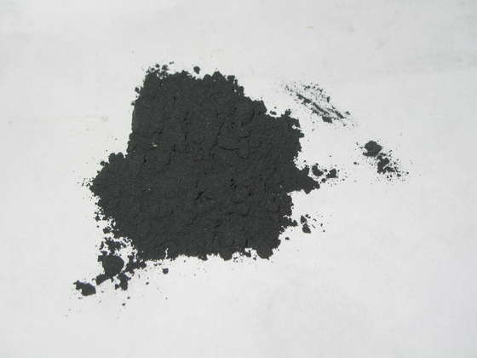
Sample Synthesis
EXAMPLE:
Polycrystals: conventional solid state reaction.
PrFeAsO: start with PrAs, Fe₂O₃ and Fe powders. Ground up stoichiometric mixtures in glovebox, pressed into pellets, sealed in silica tubes in argon, and then heated at 1200ºC for 30 hrs. [11]
Figure 2 A picture of what PrFeAsO powder looks like

Slide 8
Transport properties
Figure 3 Temperature dependence of electrical resistivity of LaFeAsO_{1-x}F_{x}. The inset is a phase diagram constructed with the data. [9]
Broad peak at T~150K is generally associated with the SDW phase transition
The transition is suppressed and shifted to a lower temperature as doping level increases
Superconductivity emerges at x=0.03

Slide 9
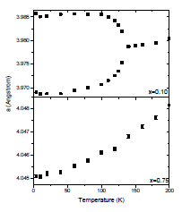
Neutron Powder Diffraction
Peak splitting: tetragonal-orthorhombic structural transition
(Extra) Magnetic peaks found at 5K
Figure 4, 5, 6 (left) NPD data for PrFeAsO [5]; (center) Lattice parameter v. Temperature data showing structural transition [Yiu Y. et al., unpublished]; (right) Lattice parameters v. doping level [8]

Slide 10
Behold! The General “1111” Phase Diagram
Suppress the following and SC will EMERGE! Structural transition, magnetic phase transition (Naïve, experimentalist point of view)
Can be done by chemical doping or applied pressure
Figure 7 The structural, magnetic, and superconducting phase diagram of PrFeAsO_{1−x}F_{x} [3]

Slide 11
Behold! The General “122” Phase Diagram
Superconductivity coexists with antiferromagnetism!??
Interesting…
Figure 8 The structural, magnetic, and superconducting phase diagram of BaFe_{2-x}Co_{x}As₂ a member from the122 family [14]

Slide 12
Theoretical models
Non BCS theory of superconductivity!?
Works suggesting the s±-pairing state
Unconventional and mediated by (nesting-related) antiferromagnetic spin fluctuations [13]
First example of multigap superconductivity with a discontinuous sign change between the bands [13]
Similar but different from the famous superconducting MgB₂ [13]
No common consensus yet

Slide 13
Conclusions
“Fe-based superconductors” is a new and exciting field
4 different types of crystal structure found in this group
The parent compounds do not superconduct, but undergo a structural distortion, a SDW phase transition and magnetic ordering instead.
These transitions can be suppressed by chemical doping or applied pressure (unexplored today) and superconductivity will emerge
No universally accepted theoretical model yet

Slide 14
References
[1] Liu R. H. et al, Phy. Review Letters, 101, 087001 (2008)
[2] Sasmal K. et al, Phy. Review Letters, 101, 107007 (2008)
[3] Rotundu C. R. et al, Phy. Review B, 80, 144517 (2009)
[4] Ren Z. A, Materials Research Innovations 12, 1 (2008)
[5] Zhao J. et al, Phy. Review B, 78, 132504 (2008)
[6] Qi Y. P. et al, Phy. Review B, 80, 054502 (2009)
[7] Wang et al, Phy, Review B, 78, 054521 (2009)
[8] Han F. et al, Phy, Review B, 80 024506 (2009)
[9] Dong J. et al, Europhys. Letter, 83, 27006 (2008)
[10] Ishida k. et al, Journal of the Phy. Socity of Japan, 78, 062001 (2009)
[11] McGuire M. A. et al, Journal of Solid State Chemistry, 182, 8, p 2326-2331 (2009)
[12] Kamihara et al., Journal of American Chemical Society, 130, 11, p. 3296+ (2008)
[13] Mazin I. I. et al., Phys. Rev. Lett., 101 057003 (2008)
[14] Wang X. F. et al., arXiv:0811.2920.

