Slide 1
Ultrafast Experiments
Hao Hu
The University of Tennessee Department of Physics and Astronomy,
Knoxville
Course: Advanced Solid State Physics II (Spring 2009)
Instructor: Elbio Dagotto
(Dated: April 23, 2009)

Slide 2
Outline
Introductions
Ultrafast lasers
The Linac Coherent Light Source X-rays
Applications
Summary

Slide 3
http://www‑ssrl.slac.stanford.edu/lcls/
Notes:
The reason for such fundamental importance of femtosecond time scale is that atomic and molecular dynamics happen on that scale. (Fig. 1) For example, the
frequency of half-oscillation of H2 atoms is about 4155 cm-1, which has the time scale of 7.6 fs. Therefore, the development of equipments with femtosecond resolution becomes extremely important to the research of ultrafast phenomena.

Slide 4
The first pulses shorter than a nanosecond were obtained by DeMaria in 1966 by passive mode locking of a Nd-glass laser
Zhou et al. (1994) obtained a pulse of 8-fs duration from a Ti-sapphire laser.
1 ns
19746
1 fs (10⁻¹⁵s)
1 ps (10⁻¹²s)
19946
19666
Shank and Ippen (1974) with tunable broad-gain dye laser media in combination with a saturable dye absorber.
Timeline of ultrafast laser
From nanosecond to femtosecond science, Rev. Mod. Phys. 71, S283 (1999)

Slide 5
(a) Laser cavity and (b) energy levels of a 3-level laser.
Laser is made of a gain medium enclosed in an optical resonator. Optical resonator is a face-to-face configuration of two mirrors, one with reflectivity less than unity in order to pass some output light.
If only three energy levels: the ground state (having energy of E1) and two excited states (of energies E2 < E3). Energy is supplied in order to “pump” the E1 → E3 transition. E3 level is then subject to fast non-radiation transition to E2, providing non-equilibrium state known as inverted population (meaning there are more atoms in E2 than E1). The E2 → E1 transition is the “laser transition”, providing laser photon of the same frequency.
http://en.wikipedia.org/wiki/Laser_construction
Notes:
The laser transition is not of a single energy, but rather a band of energies (and corresponding photon frequencies). Depending on the gain spectral, more than one mode can be amplified. Hence, many laser frequencies can be presented on the output - a multimode laser.
Figure

Slide 6
Mode locking
Mode-locking is a technique by which a laser can be made to produce pulses of light of extremely short duration, on the order of picoseconds (10⁻¹²s) or femtoseconds (10⁻¹⁵s).
Eigen frequencies in 1D resonator of length L are given by the condition
ν=cn/2L, n is the number of modes
In general, each of these modes oscillate independently with random phase.
Each mode operates with a fixed phase locked to the same value----constructively interfere with each other----producing an intense pulse of light.
Passive modelocking
A saturable absorber is placed in the cavity. It behaves differently depending on the intensity of the light passing through it. Ideally a saturable absorber will selectively absorb low-intensity light, and transmit light which is of sufficiently high intensity.
NATURE VOL 424 14 AUGUST 2003
Notes:
Such an
absorber introduces some loss to the intracavity laser radiation, which
is relatively large for low intensities but significantly smaller for a short
pulse with high intensity.

Slide 7
Advantage of ultrafast laser
Ultrashort pulse duration allows fast temporal resolution.
A modelocked laser can ‘freeze’ the motion of fast moving objects such as molecules or electrons and therefore can measure the relaxation processes of carriers in semiconductors, chemical reaction dynamics and electro-optical sampling of high-speed electronics.
High pulse repetition rate
Lasers with multi-gigahertz repetition rates are key components of many applications.
High peak intensity
The high peak intensity of the pulse can be used to alter materials by ‘cold’ ablation (when a material is changed to gas directly from a solid) or to generate other colours/wavelengths through nonlinear frequency conversion.
NATURE VOL 424 14 AUGUST 2003

Slide 8
Introducing the Linac Coherent Light Source X-rays
X-rays have a wavelength approximately equal to the distances between atoms, it has the potential to give a complete, global picture of structural changes, without any ambiguity in the interpretation. The x-ray photons scatter from all the electrons in the sample, so the diffracted intensity depends directly on the electronic density. Since most electrons follow the nuclei, the electronic
density closely reflects the atomic structure.
The LCLS is dramatically different from any x-ray source ever built thanks to its laser properties:
exceptionally bright, coherent, coherent means all the x-ray photons are in
phase with each other and going in the same direction, and short pulses of x-ray light.
It is also different from any other laser because it will produce light at x-ray wavelengths that can probe matter on the atomic scale.
LCLS will take clear pictures at these phenomenal speeds, from 230 femtoseconds down to 1 femtosecond.
Notes:
but if the process under study involves structural change, one only receives very indirect tidings.

Slide 9
The LCLS, and other XFELs of its kind, will produce laser like pulses of X‑rays of about 100 fs duration and 10¹² photons per pulse.
Notes:
Like a lightning-quick strobe light, LCLS will take freeze-frame snapshots—essentially x-ray motion pictures—of phenomena no other machine or eye can see. This is the astonishingly small realm of molecules and atoms, where everything hums, vibrates, and changes states and locations in quadrillionths of a second.

Slide 10
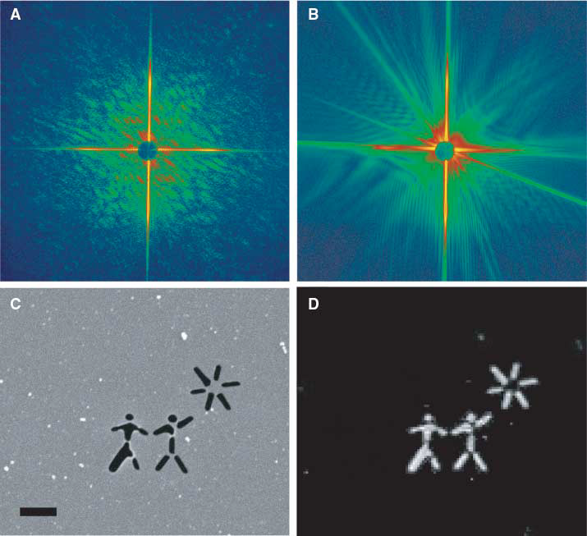
Radiation damage limits the highest resolution
achievable with coherent diffractive imaging.
So people developed the “flash” imaging technique(single-pulse image).
From Fig A and B, it demonstrates that an interpretable coherent diffraction pattern with excellent signal to noise can be collected from a small isolated object in a single FEL
pulse.
(A) Diffraction pattern recorded with a single FEL pulse from a test object placed in the 20-mm focus of the beam . (B) The diffraction pattern recorded with a second FEL pulse selected with a fast shutter, showing diffraction from the hole in the sample created by the first pulse. (C) SEM image of the test object (D) The image reconstructed from the single-shot diffraction pattern shown in (A)
K. J. Gaffney, et al. Science 316, 1444 (2007)
Notes:
(C) Scanning electron
microscope image of the test object, which was fabricated by ion-beam milling a 20-nm-thick silicon
nitride membrane. The scale bar denotes 1 mm. (D) The image reconstructed from the single-shot
diffraction pattern shown in (A)

Slide 11
Summary
The progress in ultrafast lasers and X-rays imaging during the past decade has been simply amazing. The continued development of these ultrafast
techniques, and their impact on our understanding of the basic interactions that determine functions in many areas from biology to superconductivity, will be driven by those developments.

Slide 12
Reference
Recent developments in compact ultrafast lasers, NATURE VOL 424 14 AUGUST 2003
From nanosecond to femtosecond science, Rev. Mod. Phys. 71, S283 (1999)
Henry n. chapman, Nature materials VOL 8 APRIL 2009
Ultrafast electron microscopy in materials science, biology, and chemistry, JOURNAL OF APPLIED PHYSICS 97, 111101 (2005)
Http://en.wikipedia.org/wiki/Laser_construction
Http://www‑ssrl.slac.stanford.edu/lcls/
K. J. Gaffney, et al. Science 316, 1444 (2007)

