Slide 1
Quantum Size Effect in the Stability and Properties of Thin Metal Films
Speaker: Xiangshi Yin
Instructor: Elbio Dagotto
Time: April 15, 2010
(Solid State II project)

Slide 2
Outline
Classical film growth modes
Quantum growth mode
QSE and free electron model
Properties of quantum film
Summary
References

Slide 3
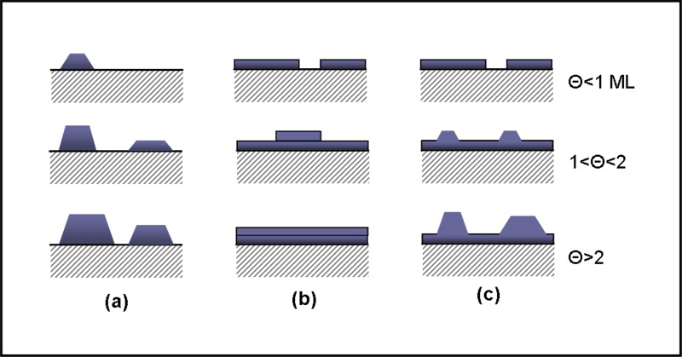
Classical film growth modes
There are three classical film growth modes
Thermodynamic parameters(such as surface and interface free energies of substrate and deposited materials) compete with the kinetic parameters(surface diffusion and deposition rate)
Thermo-equilibrium configuration
Layer-by-layer(Frank-van der Merwe, FM)
Complete islanding(Volmer-Weber, VM)
Layer plus Islanding(Stranski-Krastanov, SK)

Slide 4
Quantum growth mode
People find some smooth metal films on semiconductors are sometimes formed at low temperature under growth conditions far away from thermo-equilibrium
In 1996, Arthur R. Smith^{[1]} provided the first striking example of the quantum growth by depositing Ag on GaAs in a two-step process

Slide 5
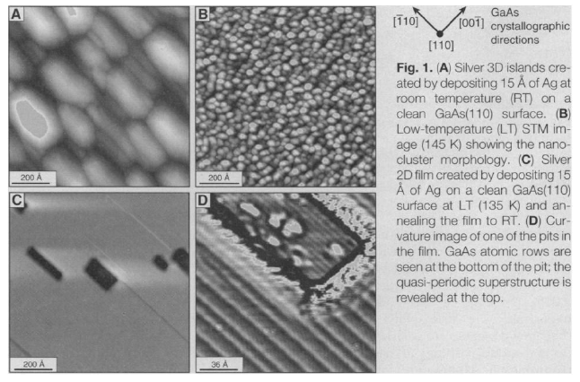

Slide 6
Characteristics of this Ag film
Two-step method
(LT deposition& RT annealing)
Large area of atomically flat metal film
Critical thickness(~6ML)

Slide 7
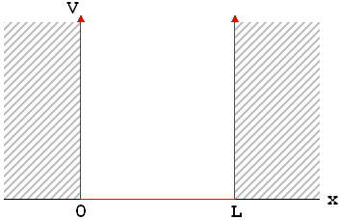
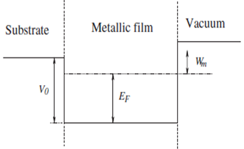
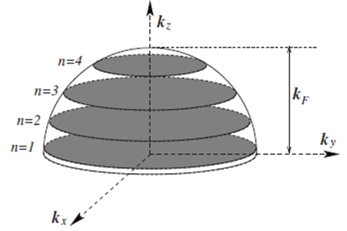
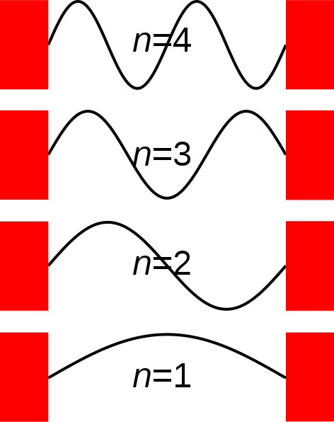
QSE and free electron model
Quantum size effect^{[2]}
Quantum Well States^{[3]}

Slide 8
The Free electron model
A collection of free electrons
Neglect the lattice potential and electron-electron interaction
Potential height doesn’t affect the analytical result substantially

Slide 9
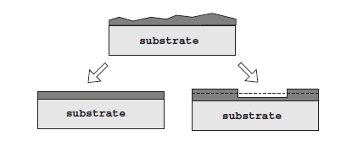
Film stability criterion
E_{t} (left)<E_{t} (right)
Flat film of L monolayer is stable only if Es(L) is convex!

Slide 10
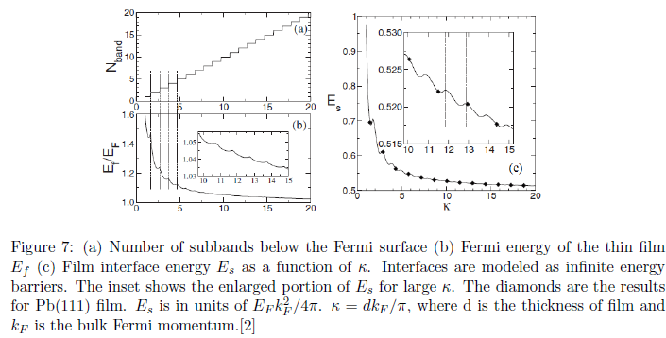
Example^{[2]}

Slide 11
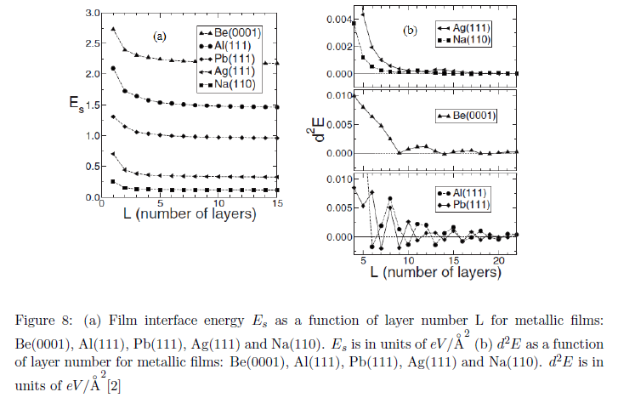

Slide 12
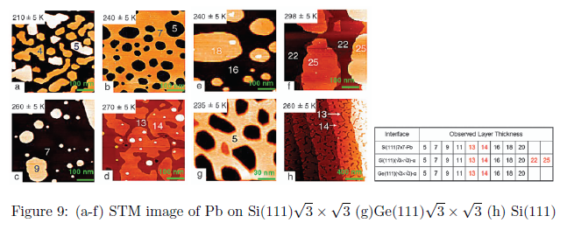
[4]

Slide 13
Friedel Oscillation
Friedel oscillations in electron density can cause strong oscillations in the electrostatic charge density and potential.
Period:

Slide 14
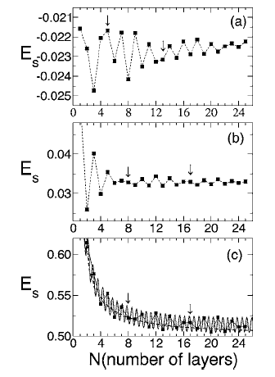
Example: Pb(111) film^{[4]}
Oscillation persists up to at least 25 ML!
DFT calculation
~ 1/z

Slide 15
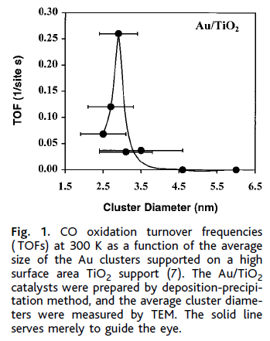
Properties of quantum films
Surface reactivity
Surface reactivity of materials is “size dependent”
It’s strongly dependent the DOS around the Fermi level
Quantum confined metal films of different thickness have the same surface structure but different electronic structures
The energetic position of the corresponding quantum well states and their decaying length directly affect the molecular orbital rehybridization upon adsorption and thereby also the catalytic properties.
Example:
Au can be very reactive catalyst for
low temperature oxidation of CO
at the nanometer scale^{[7]}

Slide 16
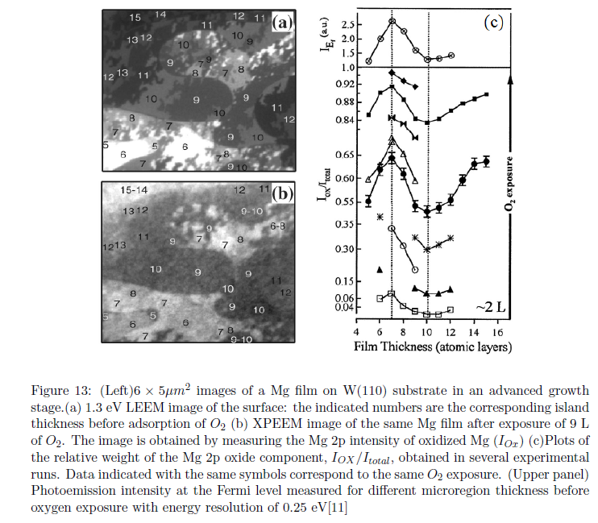

Slide 17
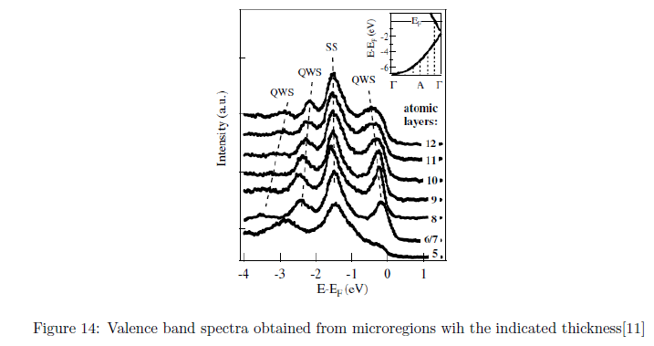

Slide 18
Summary
Quantum growth mode is a new thin film growth mode, in which the quantum confinement of itinerant electrons plays an important role in the film stability.
Quantum film has a lot of interesting physical properties.

Slide 19
References
[1] A. R. Smith, K. –J. Chao, Q. Niu, C.-K. Shih, Science 273, 226 (1996)
[2] B. A. Wu, Z. Zhang, Phys. Rev. B 77, 035410 (2008)
[3] T. –C. Chiang, Surf. Sci. Rep. 39, 181 (2000)
[4] M. M. Ozer, Y. Jia, B. Wu, Z. Y. Zhang, H. H. Weitering, Phys. Rev. B 72, 113409 (2005)
[5] M. Valden, X. Lai, and D. W. Goodman, Science 281, 1647 (1998)
[6] L. Aballe, A. Barinov, A. Locatelli, S. Heun, M. Kiskinova, Phys. Rev. Lett. 93, 196103 (2004)
[7] M. M. Ozer, C. –Z. Wang, Z. Zhang, H. H. Weitering, J. Low. Temp. Phys. 157, 221 (2009)

