Slide 1
Neutron Facilities around the world
Yuen Yiu
Physics 672, Solid State Physics II
Instructor: Pr. Elbio Dagotto

Slide 2
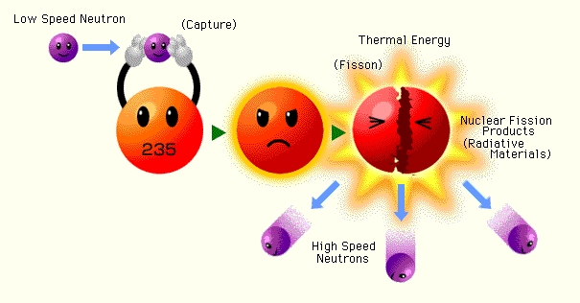
Fission
Facts: The cost to build a nuclear power plant varies from $3-5 billion each, and usually can power a city about the size of Knoxville (200,000 homes)
Good:
Cheaper to build (not anymore?) and to maintain (HFIR’s budget is around $60M/yr)
Continuous neutrons!
Bad:
High heat (~200MeV/neutron), good for power production, not for neutron production
Fuel cost fluctuations (Uranium $20/lb in 2005 to $110/lb in 2007!)
Fuel cycles resulting downtime
Limitations: Uranium usage, highly enriched vs moderately enriched, number of beam tubes (future modifications), etc.

Slide 3
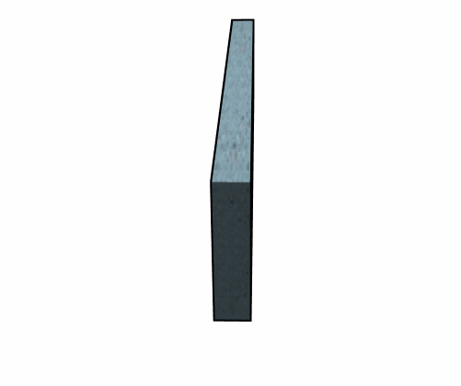
Spallation
Good:
Low heat (~25MeV/neutron), low restriction on neutron production
Pulsed neutrons!
No fuel cycle!
Bad:
Expensive to build ($1.4 billion for SNS) AND to maintain ($200M/yr for SNS), but might be offset if divided by number of operating instruments (?)
Need more land (?)

Slide 4
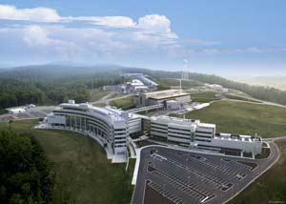
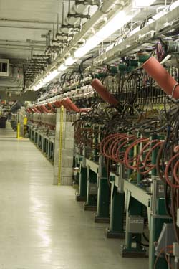
SNS @ ORNL
← Linear Accelerator at SNS
Spallation Neutron Source @ Oak Ridge National Laboratory
Costs: $1.4 billion
Running since: 2006 (Construction started in 1999, new target building commissioned?)
Number of available instruments: 12
Number of instruments currently under construction: 7
Closest major city: Knoxville, TN (25 mi)

Slide 5
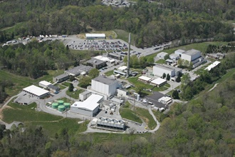
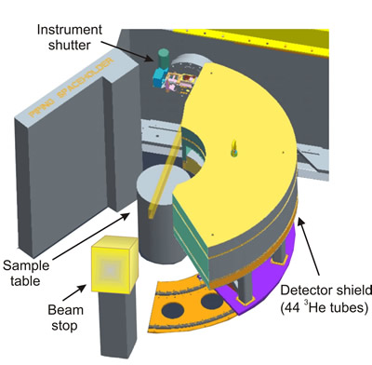
HFIR @ ORNL
A schematic for the Neutron Powder Spectrometer (HB-2A) at HFIR
High Flux Isotope Reactor @ Oak Ridge National Laboratory
Running since: 1966 (Construction started in 1961)
Number of available instruments: 8
Number of instruments currently under construction: 3
Closest major city: Knoxville, TN (25 mi)

Slide 6
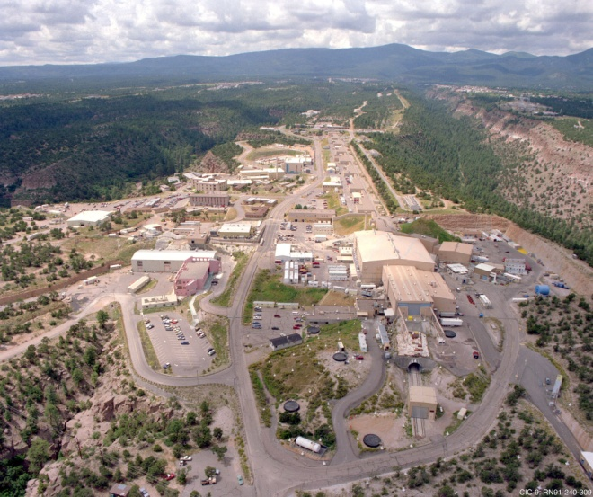
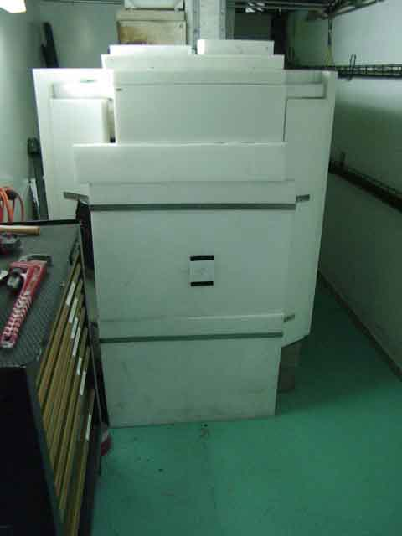
LANSCE @ LANL
←Beam stopper for the Surface Profile Analysis Reflectometer (SPEAR) at the Lujan Center
Los Alamos Neutron Science Center @ Los Alamos National Laboratory
Running since: 1972
Number of available instruments: 13 (Lujan Neutron Scattering Center)
Closest urban area: Albuquerque, NM (97 mi)

Slide 7
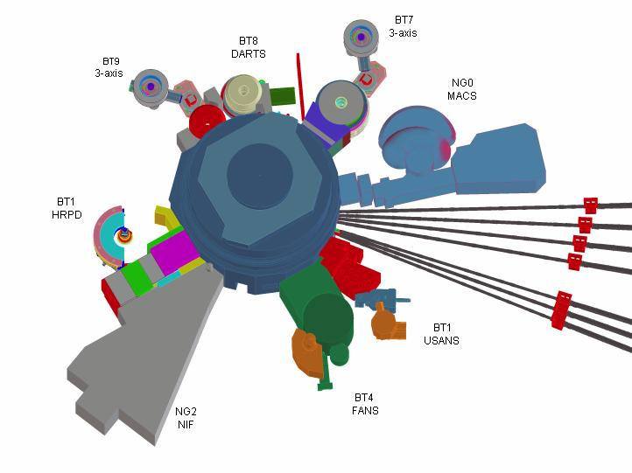
NCNR @ NIST
NIST Center for Neutron Research @ National Institute of Standards and Technology
Running since: 1970’s
Number of available instruments: 22
Number of instruments currently under construction: MACS- Multi-Angle Crystal Spectrometer
Closest urban area: Washington D.C. (26 mi)
A schematic for the thermal neutron instrumentations in the confinement building at NCNR. Also visible on the right side of the diagram are neutron guides for the cold neutron instruments

Slide 8
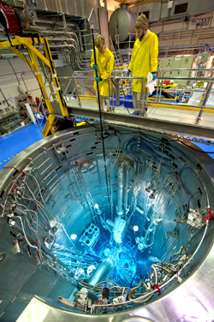
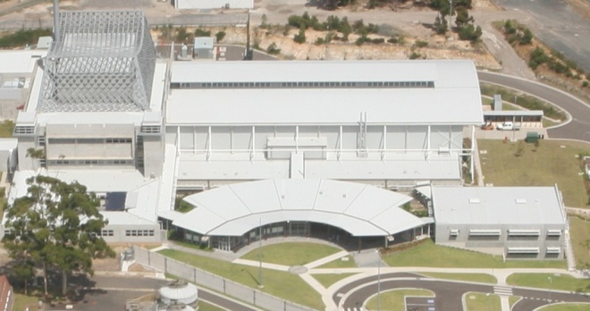
OPAL for ANSTO
Open Pool Australian Lightwater reactor (OPAL) of Australian Nuclear Science and Technology Organization
Running since: 2007
Number of available instruments: 6
Number of instruments currently under construction: 7
Closest urban area: Sydney (25 mi)
OPAL open pool reactor showing Cherenkov radiation in action

Slide 9
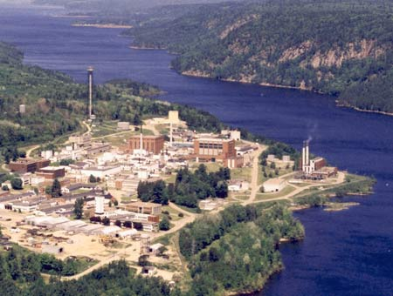
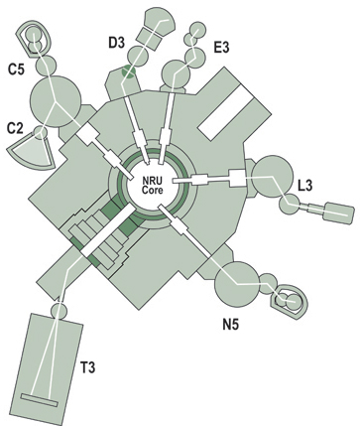
NRC-CNBC @ CRL
← Diagram of neutron instruments at CNBC
National Research Council Canadian Neutron Beam Center (NRC-CNBC) @ Chalk River Laboratories
Running since: 1957
Number of available instruments: 7
Closest urban area: Ottawa (115 mi)

Slide 10
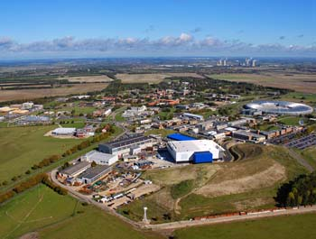
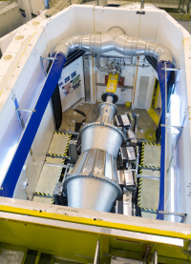
ISIS @ RAL
Nimrod is a near and intermediate range order diffractometer designed to provide continuous access to length scales ranging from the interatomic (<1 Å) through to the mesoscopic (>300 Å).
ISIS Spallation Source @ Rutherford-Appleton Laboratory
Running since: 1985
Number of available instruments: 36
Closest urban area: Oxford (13 mi), London (50 mi)

Slide 11
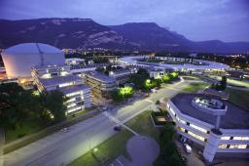
ILL
Institut Laue–Langevin (ILL)
Running since: 1967
Neutron source: Nuclear Fission
Number of available instruments: 46
Closest urban area: Grenoble (in city, 3 mi from city center)

Slide 12
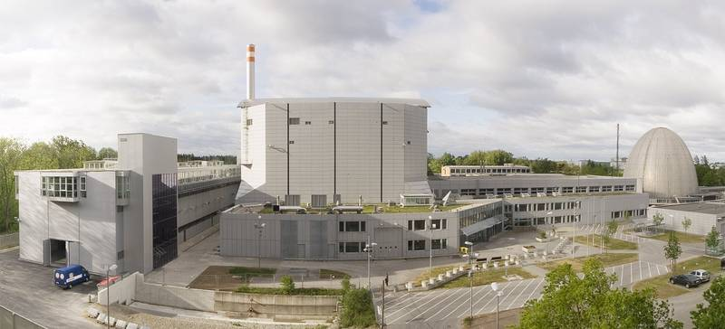
FRM II @ Tech. Univ. of Garching
Forschungsreaktor München II (FRM II) @ Technical University of Garching
Running since: 2005
Closest urban area: Munich (12mi)

Slide 13
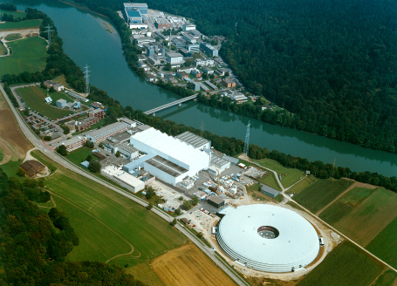
SINQ @ PSI
Swiss Spallation Neutron Source (SINQ) @ Paul Scherrer Institute
Running since: 1996
Number of available instruments: 19
Number of instruments currently under construction: 3
Closest urban area: Zurich (22 mi)

Slide 14
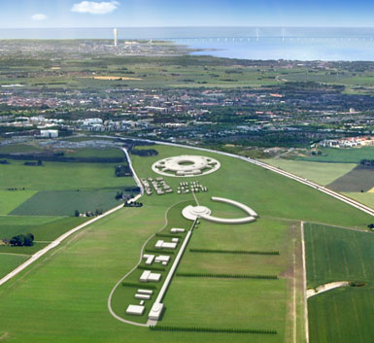
ESSS
European Spallation Source Scandanavia (ESSS) (project)
Will cost: 1.5 billion Euros
Running since: 2020 (projected)
Neutron source: Spallation
Closest urban area: Copenhagen, Denmark (40 mi)

Slide 15
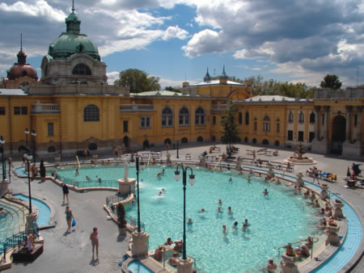
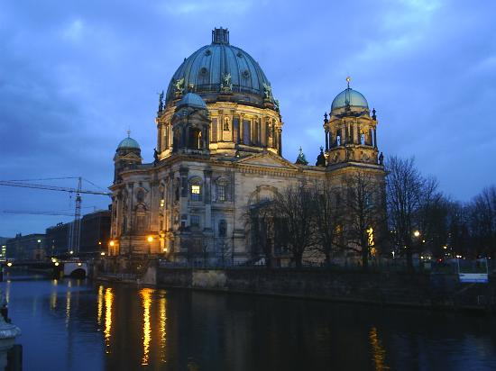
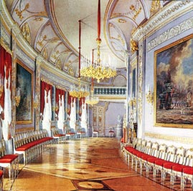
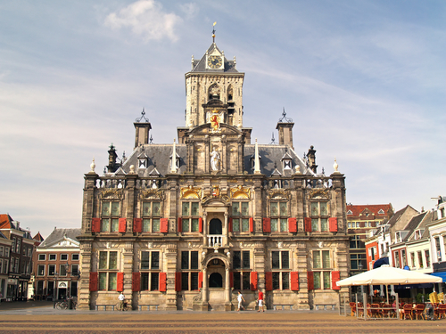
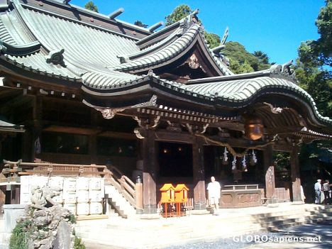
Other neutron facilities
Americas
University of Missouri Research Reactor Center
Indiana University Cyclotron Facility
Europe
Leon Brillouin Laboratory, Saclay, France
Berlin Neutron Scattering Center, Germany
GKSS Geesthacht, Germany
Juelich Center for Neutron Science, Germany
Budapest Neutron Centre, Hungary
RID, Delft, The Netherlands
Frank Laboratory of Neutron Physics, Dubna, Russia
St. Petersburg Neutron Physics Institute, Gatchina, Russia
Asia
ISSP Neutron Scattering Laboratory, Tokai, Japan
JAEA Research Reactors, Tokai, Japan
KENS Neutron Scattering Facility, , Japan
Hi-Flux Advanced Neutron Application Reactor, Korea

Slide 16
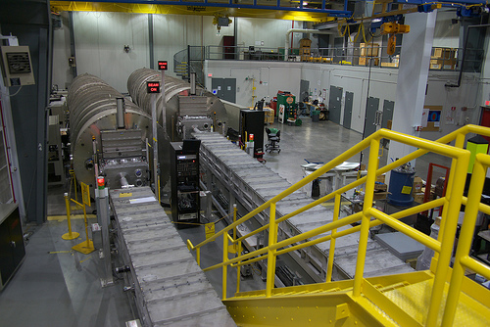
For science!

Slide 17
References
http://neutrons.ornl.gov/facilities/SNS/
http://neutrons.ornl.gov/facilities/HFIR/
http://lansce.lanl.gov/
http://www.ncnr.nist.gov/
http://www.ansto.gov.au/research/bragg_institute
http://www.nrc-cnrc.gc.ca/eng/ibp/cnbc.html
http://www.isis.stfc.ac.uk/index.html
http://www.ill.eu/
http://www.frm2.tum.de/en/index.html
http://sinq.web.psi.ch/
http://ess-scandinavia.eu/

